Slide 1
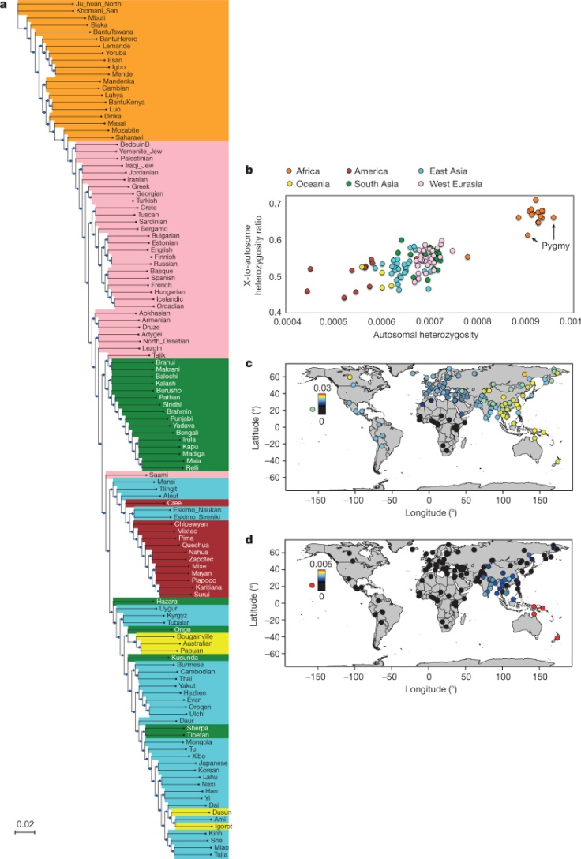
Genetic variation in the SGDP
S Mallick et al. Nature 1–6 (2016) doi:10.1038/nature18964

